Slide 1
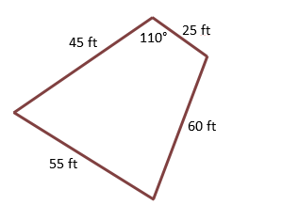
Trigonometry, Sine Rule, Cosine Rule & Area
Jill, a surveyor, needs to approximate the area of a piece of land. She walks the perimeter of the land and measures the side distances and one angle, as shown below. Using the Pythagorean theorem or Heron, calculate the area of the piece of land. (Round to the nearest hundredth).

